Slide 1
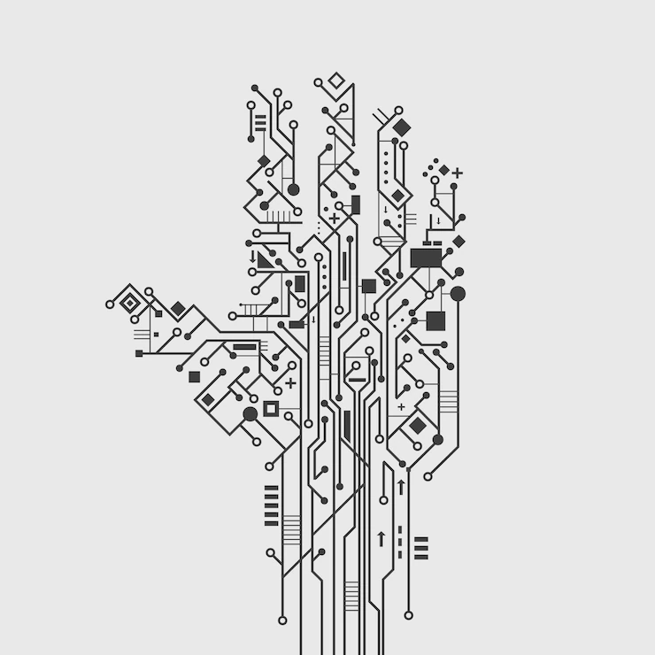

HOME SECURITY SYSTEM USING RASPBERRY PI WITH IOT
PRESENTED BY:
Ayush Gupta [20102018]
Divya Singh [20102019]
UNDER THE SUPERVISION OF:
Ms.Monika
Department Of ECE
Jaypee Institute of Information Technology, Noida , UP, India

Slide 2
TODAY'S OVERVIEW
MAJOR TALKING POINTS:
Abstract
Introduction
Scope of project
Impact of IOT on anti-theft technology
Work done in this dimension
Our solution
Components and sensors
Alternatives
Conclusion
References
MINOR PROJECT PRESENTATION
PITCH DECK | SEPT. 2020

Slide 3
ABSTRACT
To secure and guard our house in our absence, we propose the 10T based Anti-theft detection and alert System using Raspberry Pi. This system monitors the entire floor for movement. One single step anywhere on the floor is tracked and user is alarmed through mail over IOT. In this system, secure flooring tile connected with IOT, when the system is to be turned on, then whoever comes inside the house it passes the information over IOT. Whenever the thief enters in the house, and steps on the floor immediately it is sensed by the sensor which passes on the signal to raspberry pi controller. The controller in turn processes it to be valid signal and then moves the camera to the area where movement was detected and then transmits it over the Internet for the home owner to check the image.
PITCH DECK | SEPT. 2020

Slide 4
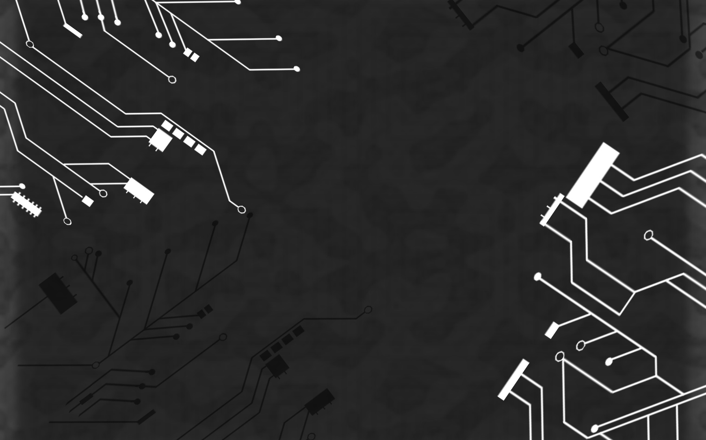
INTRODUCTION
Need for security system
Home security system is the most sort after mechanism to ensure the safety of valuables and to safeguard personal security as well. The development of burglar alert gadgets can limit the event of theft, while it can also identify and record suspicious trespassing. In places with high density like railroad stations and schools we can install face acknowledgment innovation which can identify hoodlums and suspicious people. Now-a-days, Security has become the most challenging task. Everyone wants safety but in present scenario, nothing is safe not even in their own houses. We generally lock houses when going out of the house. But just locking the home is not enough, there must be a system which safety our home, belongings and income from theft is the necessary requirements for home security system and keep track of the activities and report to the owner accordingly and works according to the response of the owner.

Slide 5

SCOPE OF THE PROJECT
THE SYSTEM CAN BE USED TO GUARD ROOMS, SECURITY VAULTS AT BANKS OR OTHER SECURITY SENSITIVE AREAS.

Slide 6
GLOBAL SCOPE OF THIS PROJECT
The widespread adoption of Internet of things (IOT) technologies has resulted in a smartly connected world to live in . It has gone into a brilliant time with a quickly developing innovation in the field of home security. The key idea of Internet of Things is to integrate each gadget/framework, for example, television, home appliances, advanced mobile phones and sensors associated with the Internet to be observed and controlled from anywhere . The primary targets of IoT are to manufacture exceptionally interconnected framework where gadgets will be the clients of the web . The Internet of Things (IoT) is a novel system administration worldview which permits the correspondence among a wide range of physical framework with the plenty of uses in the fields of agriculture, medicine, home security to name a few.

Slide 7
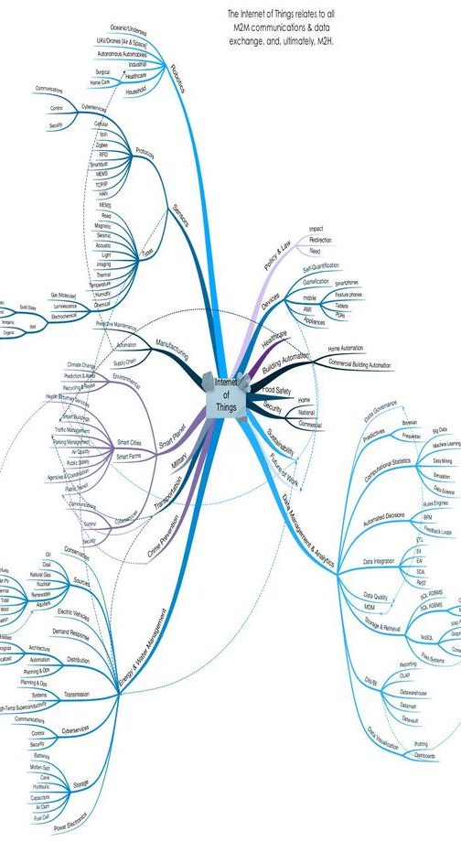
IMPACT OF IOT ON ANTI THEFT TECHNOLOGY
TRANSFORMING SECURITY
The widespread adoption of Internet of things (IOT) technologies has resulted in a smartly connected world to live in. The key idea of Internet of Things is to integrate each gadget/framework, for example, television, home appliances, advanced mobile phones and sensors associated with the Internet to be observed and controlled from anywhere. The objective and scope of the design built in this paper is to develop an efficient and low-cost system that constantly screens the region where it is installed to recognize any suspicious activities or trespassers. IOT based system is superior to other methods that are used for home security purposes. IoT based system is quite costly and have a few disadvantages in effectiveness and availability to the client.

Slide 8
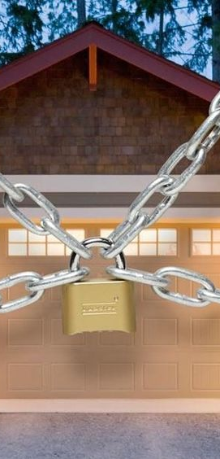
IMPACT OF IOT (CONTD.)
SERVICE LIKE NO OTHER
IoT based anti theft systems are implemented on vehicles successfully. So, we propose this system consisting of PIR, IR, Piezoelectric and Sound sensors. A camera and Raspberry pi circuit is employed with a USB drive to enable storage. When a movement is detected in the secured zone, the system with the assistance of a camera captures the pictures and video to recognize the zone of movement. The raspberry controller presently transmits the pictures and video over IOT to be seen by the client on the web. Likewise, it stores the information in USB for further reference. The client would now be able to interpret the information sent on the web through IoT to see the pictures of the incident remotely and the Raspberry Pi to start the signal alert.

Slide 9


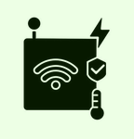
Work done in this dimension
LOCK AND KEY
CCTV SURVEILLANCE
SENSOR SECURITY

Slide 10
PROPOSED SOLUTION
ANTI-THEFT DETECTION USING RASPBERRY PI
Whenever the thief enters in the house, and the steps on the floor immediately it is sensed by the sensor which passes on the signal to the raspberry pi controller. The controller in turn processes it to be valid signal and then moves the camera to the area where the movement was detected and then transmits it over the internet for the home owner to check the image.

Slide 11

Components and sensors used

Slide 12
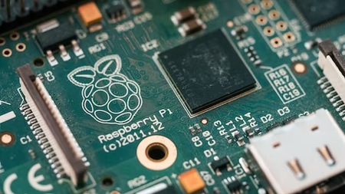
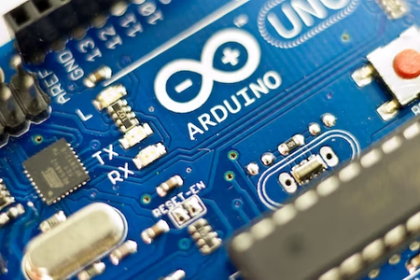
USED
ALTERNATIVE
RASPBERRY PI 3
ARDUINO UNO

Slide 13

ABOUT RASPBERRY PI
The Raspberry Pi 3 Model B is the third generation Raspberry Pi. This powerful credit-card sized single board computer can be used for many applications and supersedes the original Raspberry Pi Model B+ and Raspberry Pi 2 Model B. Whilst maintaining the popular board format the Raspberry Pi 3 Model B brings you a more powerful processer, 10x faster than the first generation Raspberry Pi. Additionally it adds wireless LAN & Bluetooth connectivity making it the ideal solution for powerful connected designs.

Slide 14
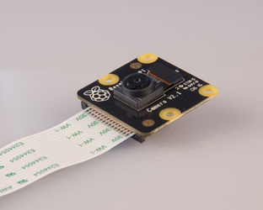
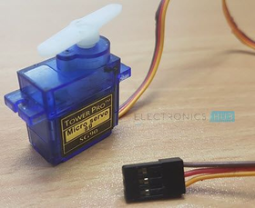
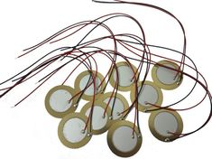
Sensors and modules used
CAMERA MODULE
SERVO MOTOR
PIEZO SENSOR

Slide 15
ABOUT
SERVO MOTOR
A SERVO MOTOR IS A TYPE OF MOTOR THAT CAN ROTATE WITH GREAT PRECISION. NORMALLY THIS TYPE OF MOTOR CONSISTS OF A CONTROL CIRCUIT THAT PROVIDES FEEDBACK ON THE CURRENT POSITION OF THE MOTOR SHAFT, THIS FEEDBACK ALLOWS THE SERVO MOTORS TO ROTATE WITH GREAT PRECISION. IF YOU WANT TO ROTATE AN OBJECT AT SOME SPECIFIC ANGLES OR DISTANCE, THEN YOU USE A SERVO MOTOR. IT IS JUST MADE UP OF A SIMPLE MOTOR WHICH RUNS THROUGH A SERVO MECHANISM.
CAMERA MODULE
PI CAMERA MODULE IS A CAMERA WHICH CAN BE USED TO TAKE PICTURES AND HIGH DEFINITION VIDEO.
Raspberry Pi Board has CSI (Camera Serial Interface) interface to which we can attach PiCamera module directly.
This Pi Camera module can attach to the Raspberry Pi’s CSI port using 15-pin ribbon cable.
PIEZO SENSOR
PIEZO SENSORS DETECT CHANGES IN THE ENVIRONMENT AND CONVERT THEM INTO ELECTRICAL ENERGY. A PIEZOELECTRIC SENSOR SENSES MECHANICAL CHANGES IN THE ENVIRONMENT AND PRODUCES A USEABLE ELECTRICAL SIGNAL OUTPUT, WHICH CAN BE USED TO MEASURE THE MECHANICAL CHANGES OR GENERATE DISPLACEMENT WITH THE ELECTRICAL OUTPUT.

Slide 16
CONCLUSION
The project "IOT Based Raspberry Pi Home Security System Using Motion Detector" has demonstrated how to get a fully functional embedded product developed from scratch. This incorporated the cross aggregation and organization of fundamental libraries, the arrangement of implanted Linux and distributed computing innovation. This system is highly recommended to home territory observation for example individual office lodge, bank storage space, stopping passage. At whatever point the movement is distinguished through. The fundamental Advantage of the undertaking is Easy to actualize, Minimal effort with High quality.

Slide 17

REFERENCE
https://ieeexplore.ieee.org/document/9404551
https://www.slideshare.net/irjetjournal/irjet-iot-based-anti-theft-detection-and-alerting-system-using-raspberry-pi
Internet of things with raspberry Pi 3: leverage the power of raspberry Pi 3 and javascript to build exciting IoT projects by Rao, Manessh

